Slide 1
Pseudo, the Index
a book recommender chatbot by suleyman saib

Slide 2
Motivations
I’ve done a lot of reading this semester and wanted to make a chatbot for my book club to help get more members engaged!
With my club, we will make a proper database of books and I will hook up the code to a Discord bot so we can promote to prospective members.

Slide 3
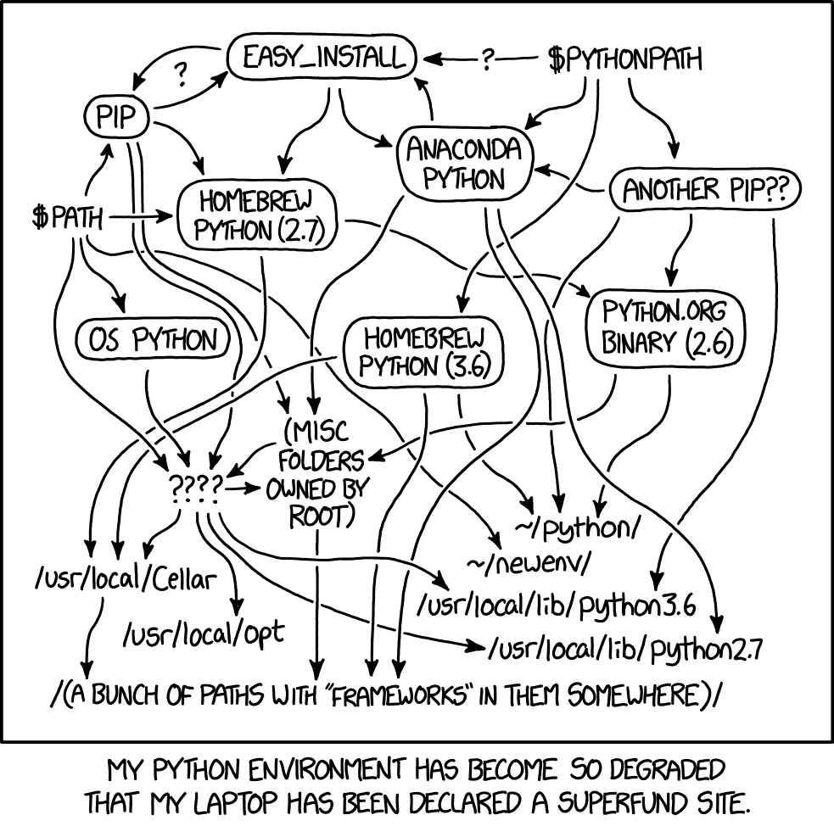
Challenges
Nothing is compatible with anything, everything sucks.
I went back to conda, like I always do :(
The documentation isn’t always accurate

Slide 4
Lessons Learned
Be more flexible! I spent maybe 60% of my time trying to justify a $10 Google Colab Pro subscription when I would have had a much easier time on my local machine.
Ask for help with what users might input, you can’t be trusted to run your own code!
Don’t give up on wacky dependency conflicts, just pray and let conda do its thing.

Slide 5
Thank you!
(and good luck on your finals!)

